Slide 1

Ecmascript 6
Node.js Training Camp - Lecture -1

Slide 2


Agenda:
ES6 key features
Common mistakes
Iterators vs Arrays
Maps vs Objects
Obsolete constructions
Asynchronous JavaScript

Slide 3
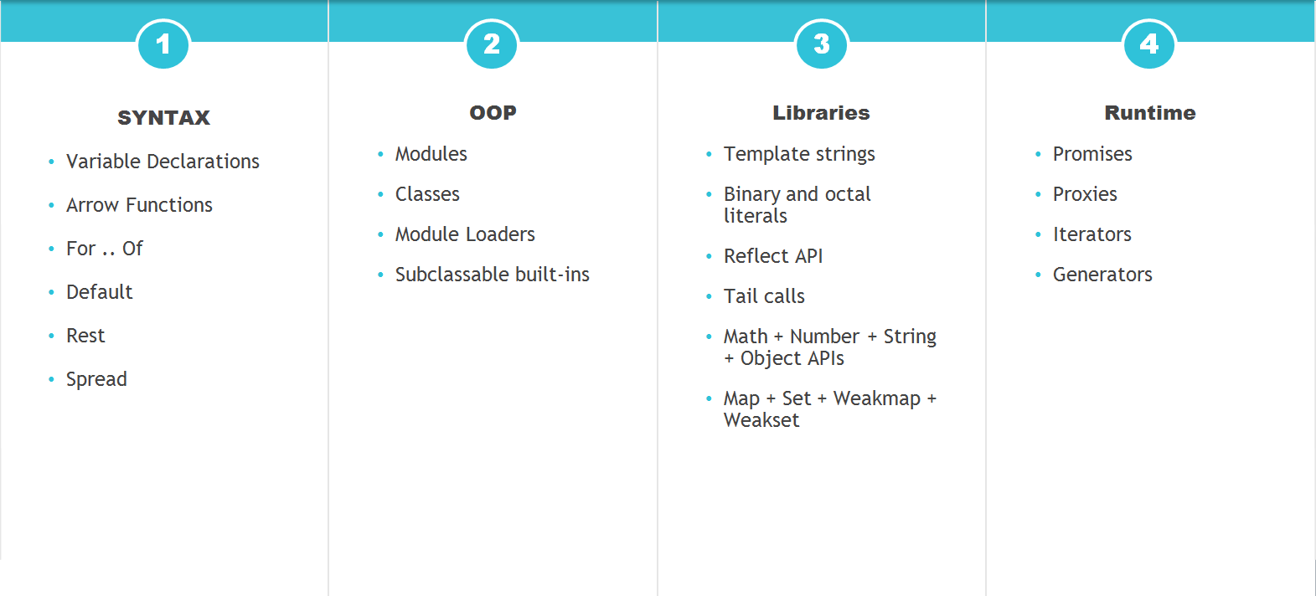
Ecmascript 6. Key features.

Slide 4
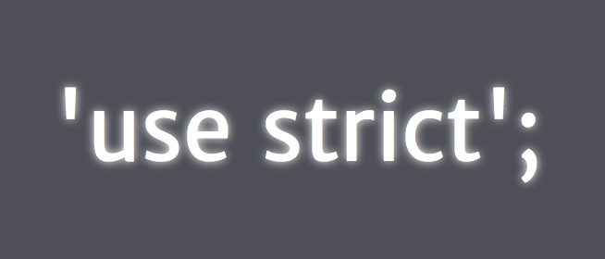
Common errors – ‘use strict’

Slide 5

Var is dead?

Slide 6
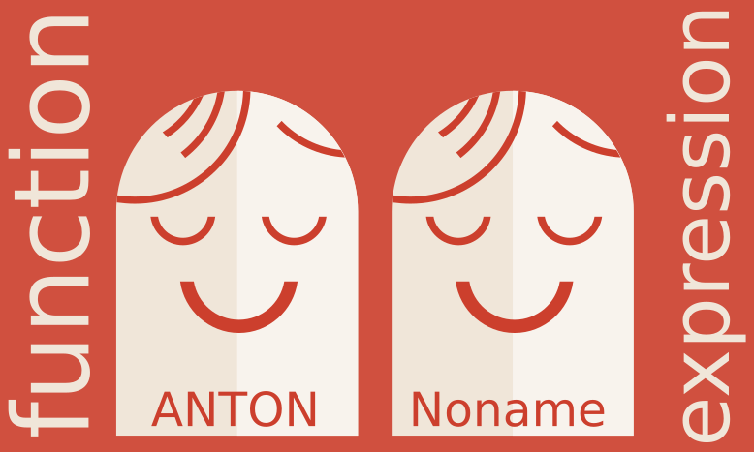
Function expression is dead?

Slide 7

Temporal dead zone

Slide 8
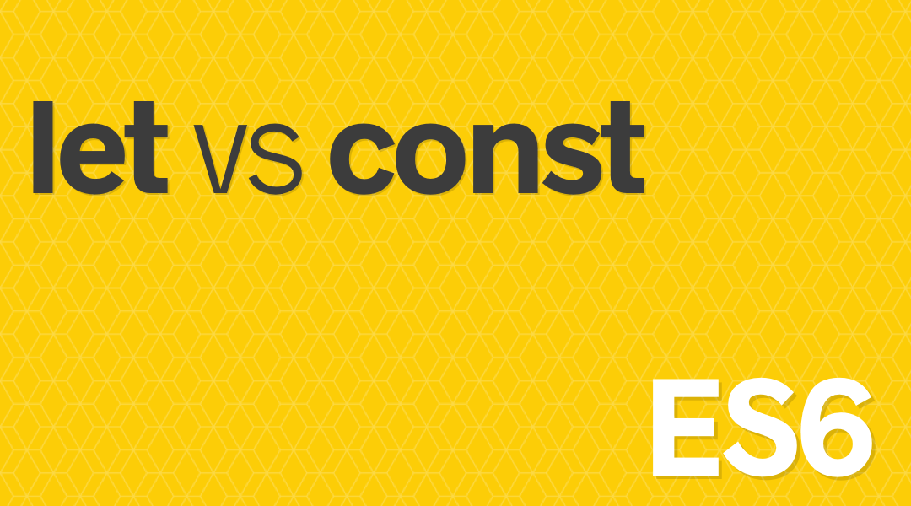
Let vs Const

Slide 9
OOP is Coming
class
constructor
extends
super
static

Slide 10
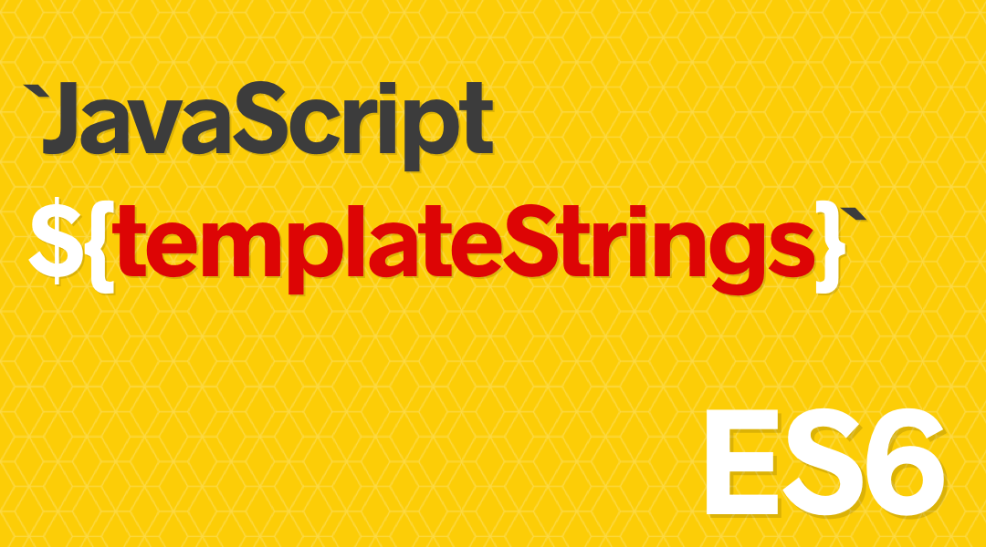
String templates

Slide 11

Iterators vs arrays

Slide 12
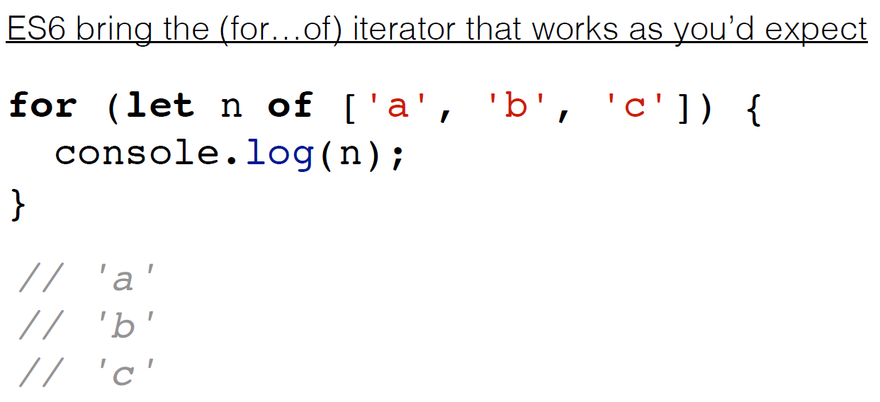
Iterator protocol

Slide 13
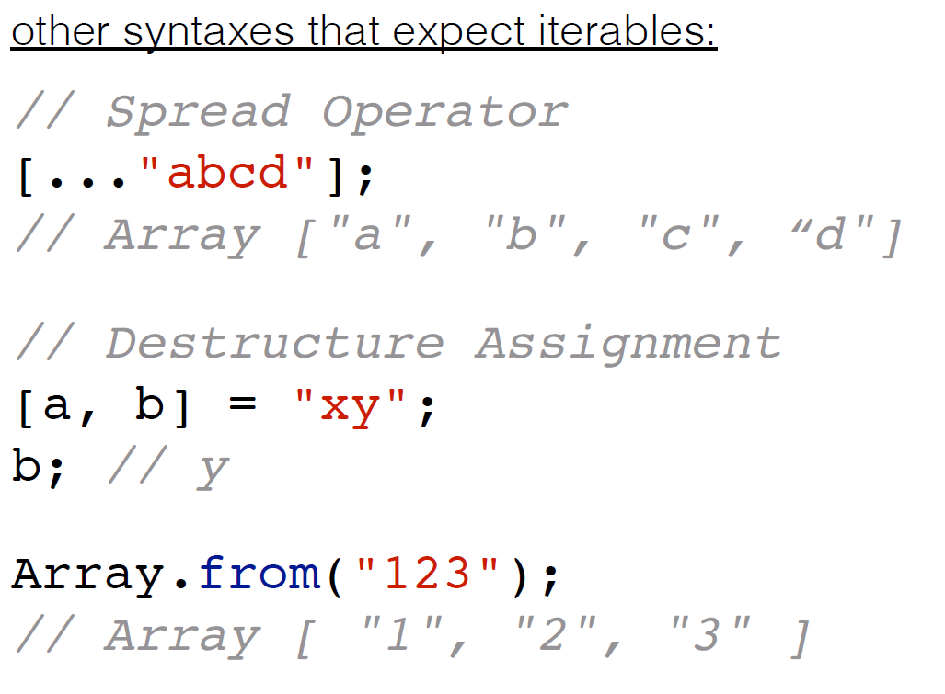
Iterators example

Slide 14
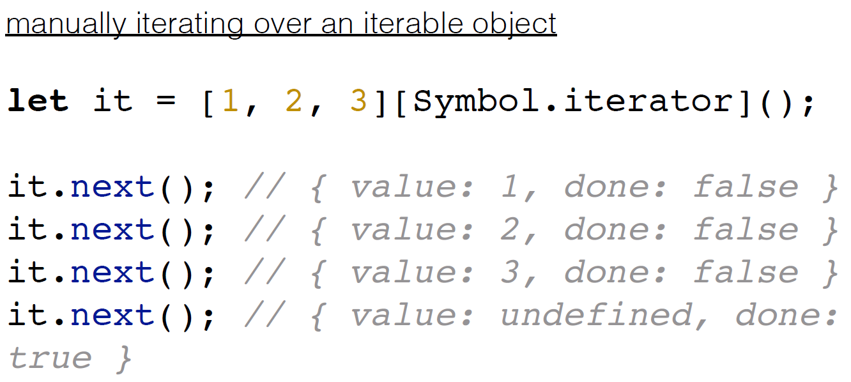
Iterators example

Slide 15
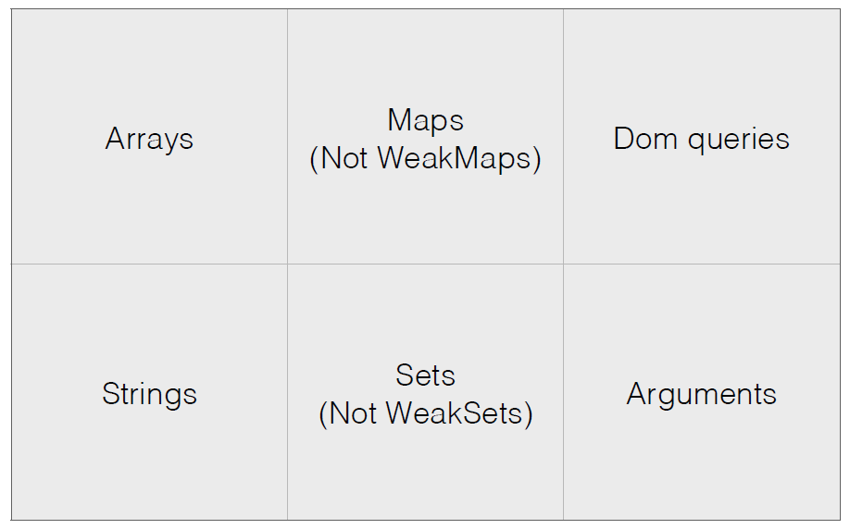
Iterable data sources

Slide 16
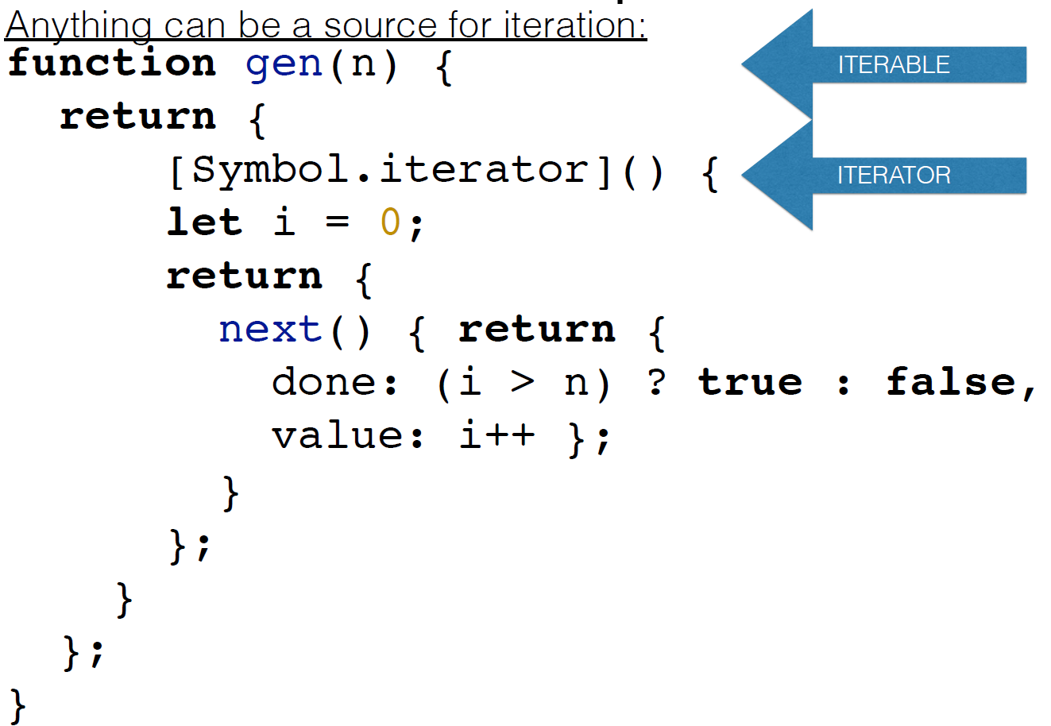
Self maked iterator

Slide 17
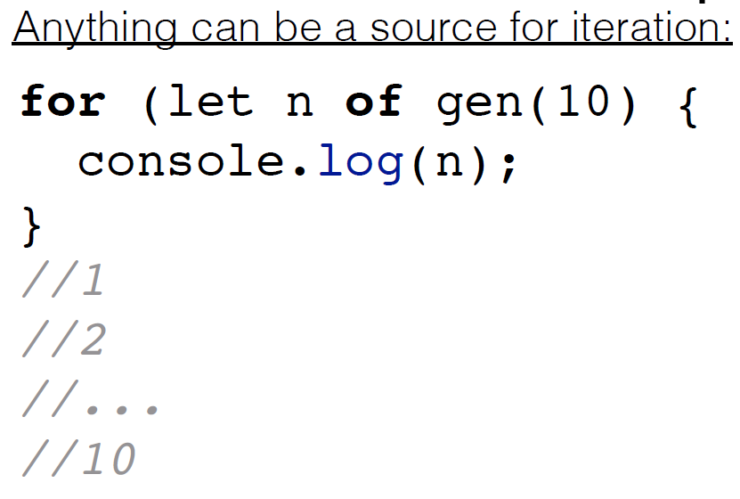
Invoke iterator

Slide 18

Map

Slide 19
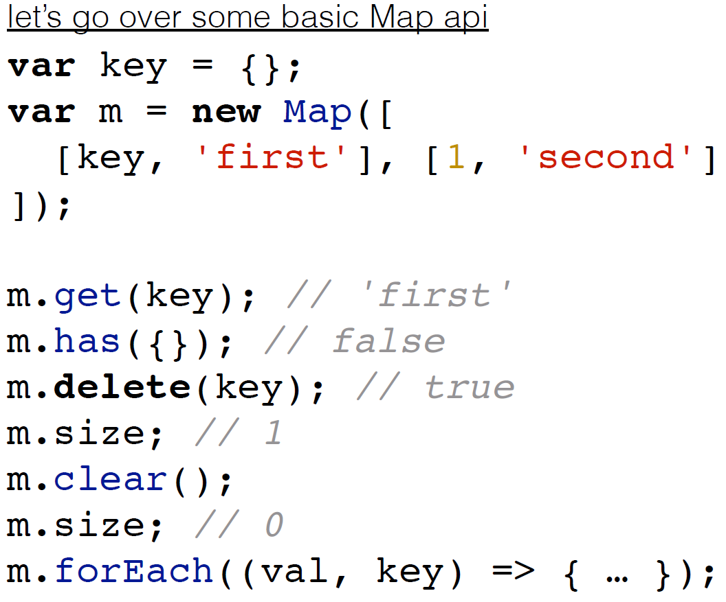
Map

Slide 20
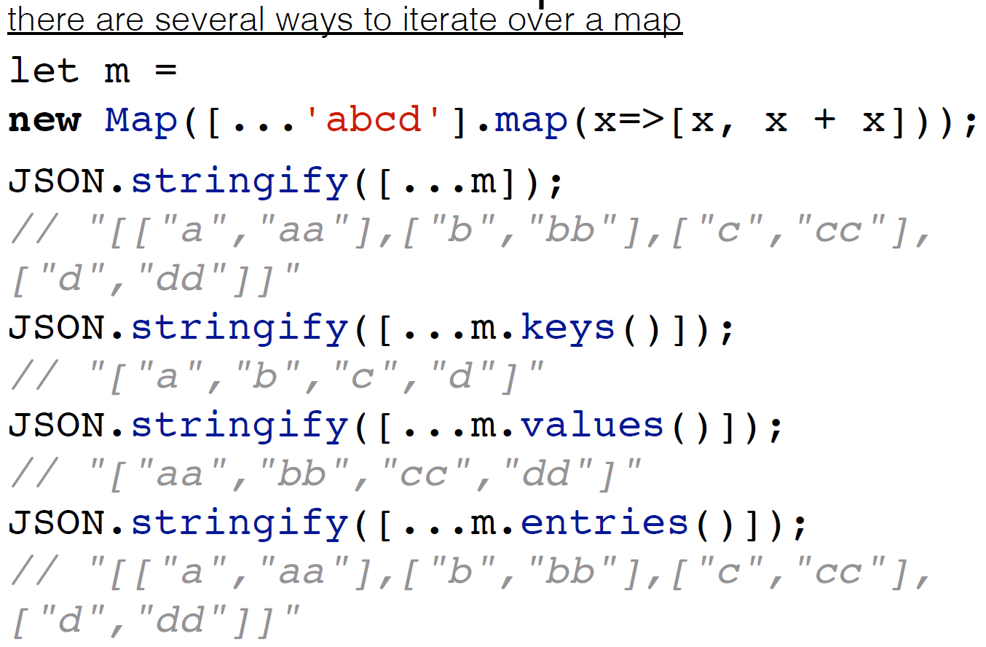
Map

Slide 21
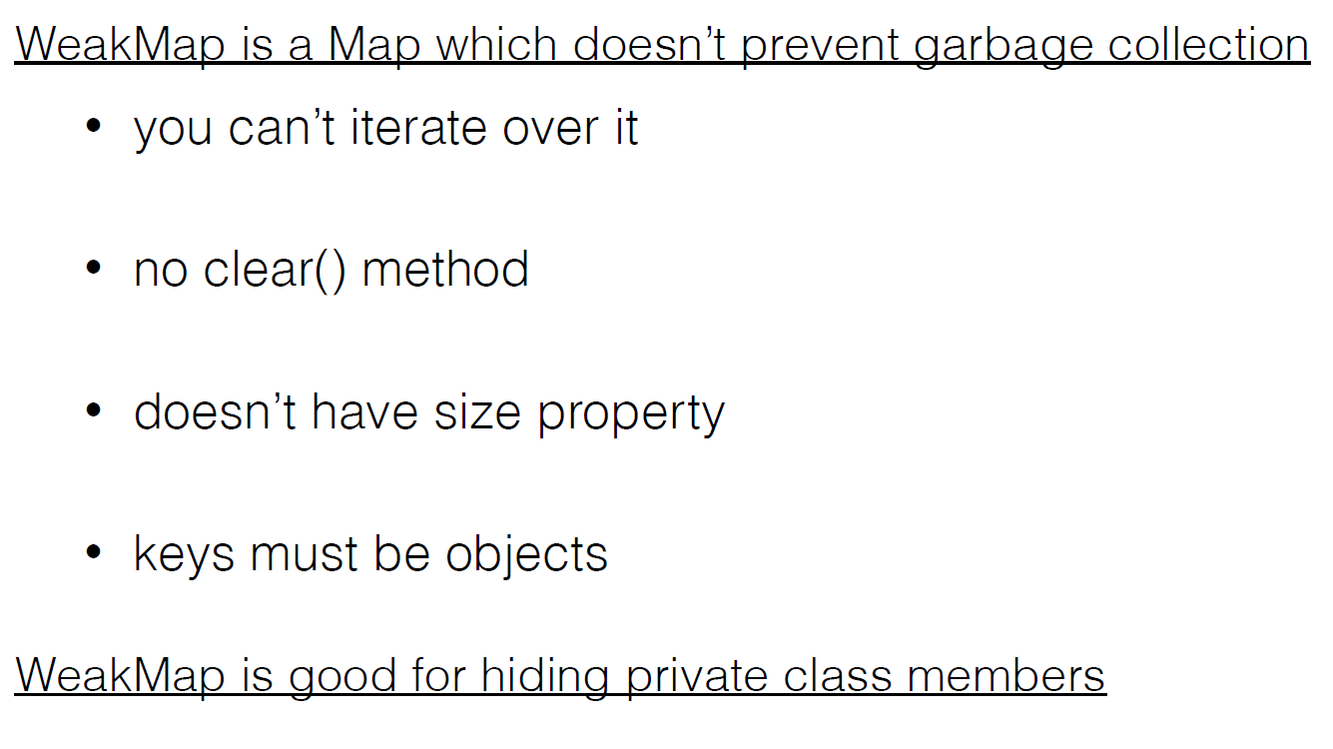
Weak map

Slide 22
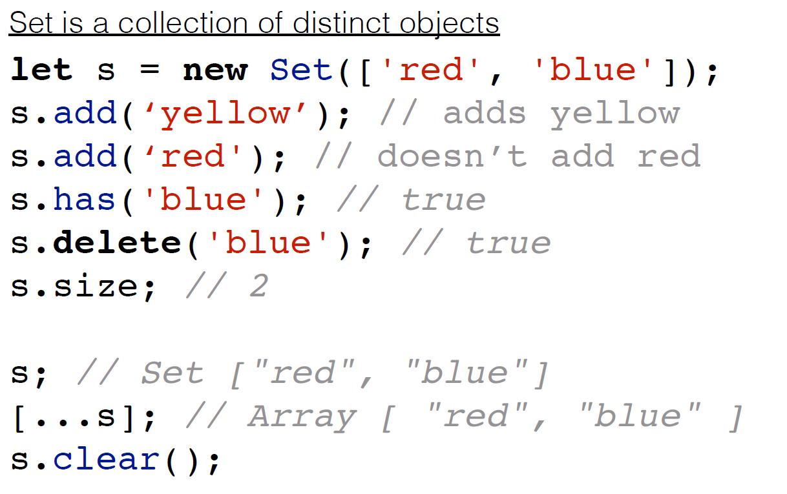
Set

Slide 23
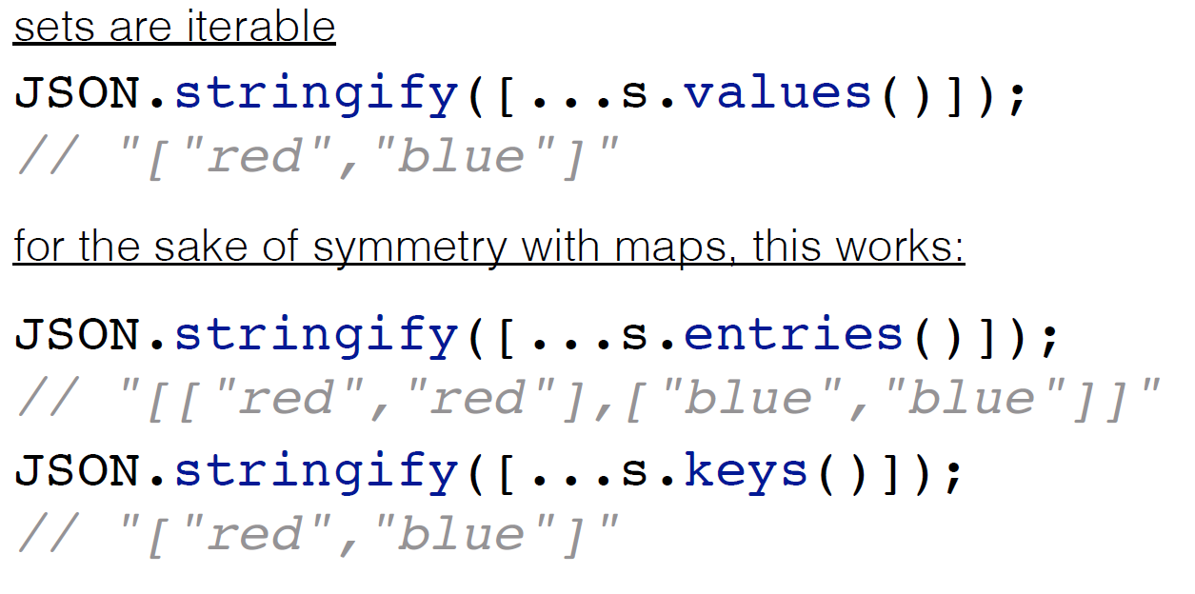
Set

Slide 24
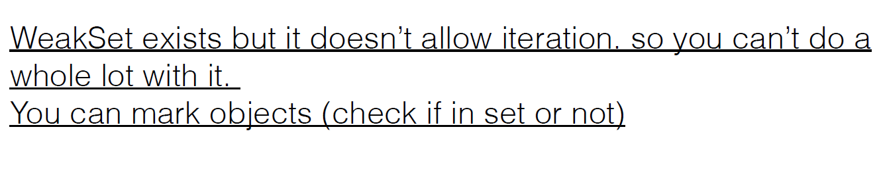
Weak set

Slide 25
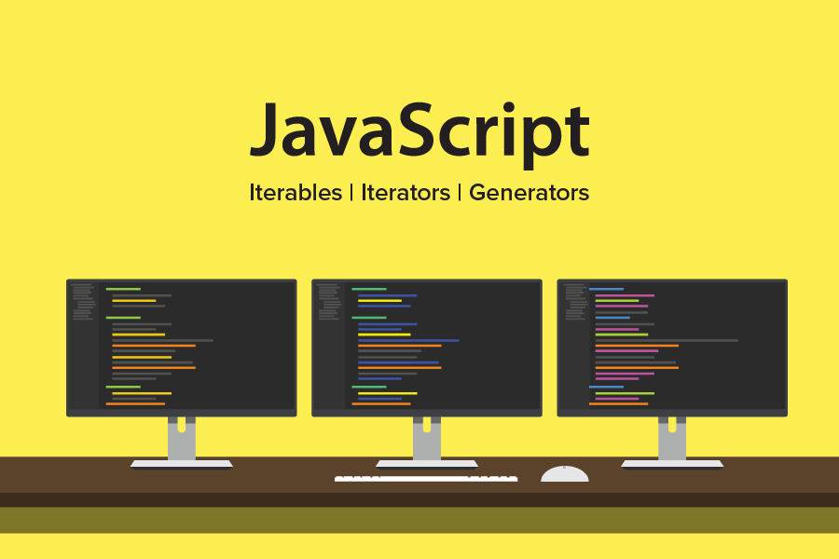
Generators

Slide 26
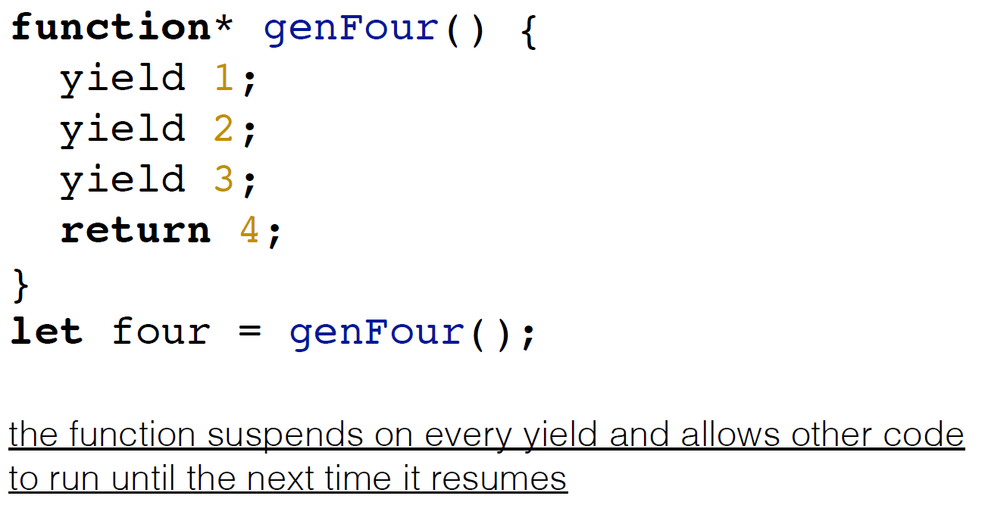
Generators

Slide 27
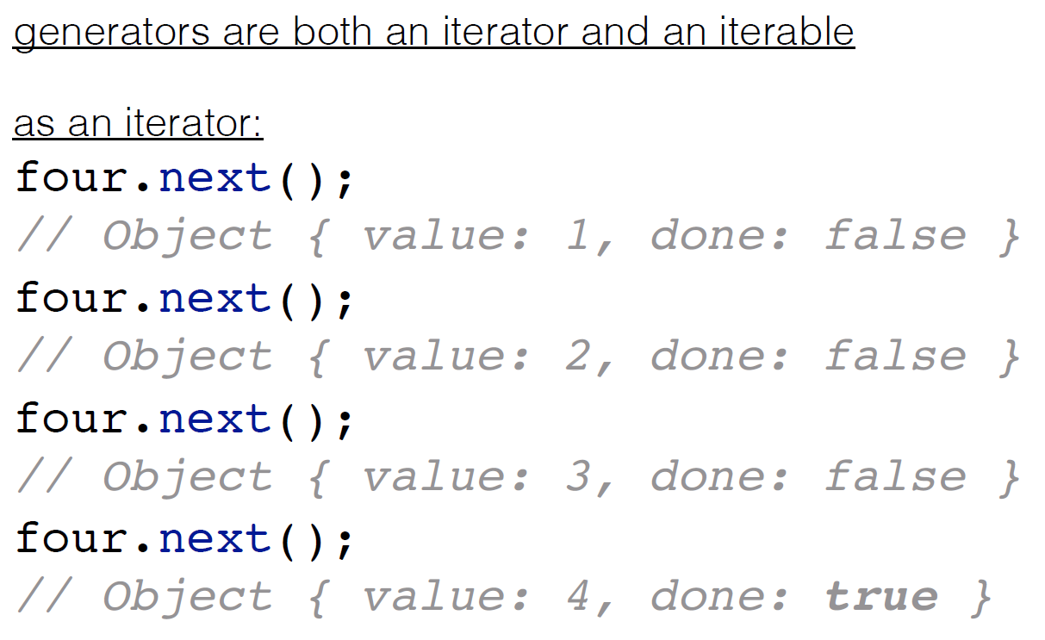
Consume generator

Slide 28
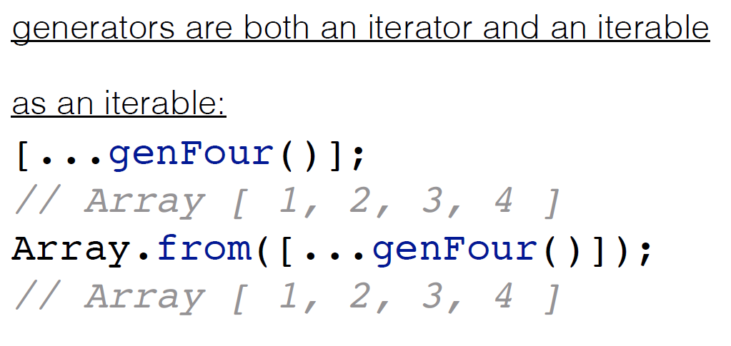
Consume generator

Slide 29
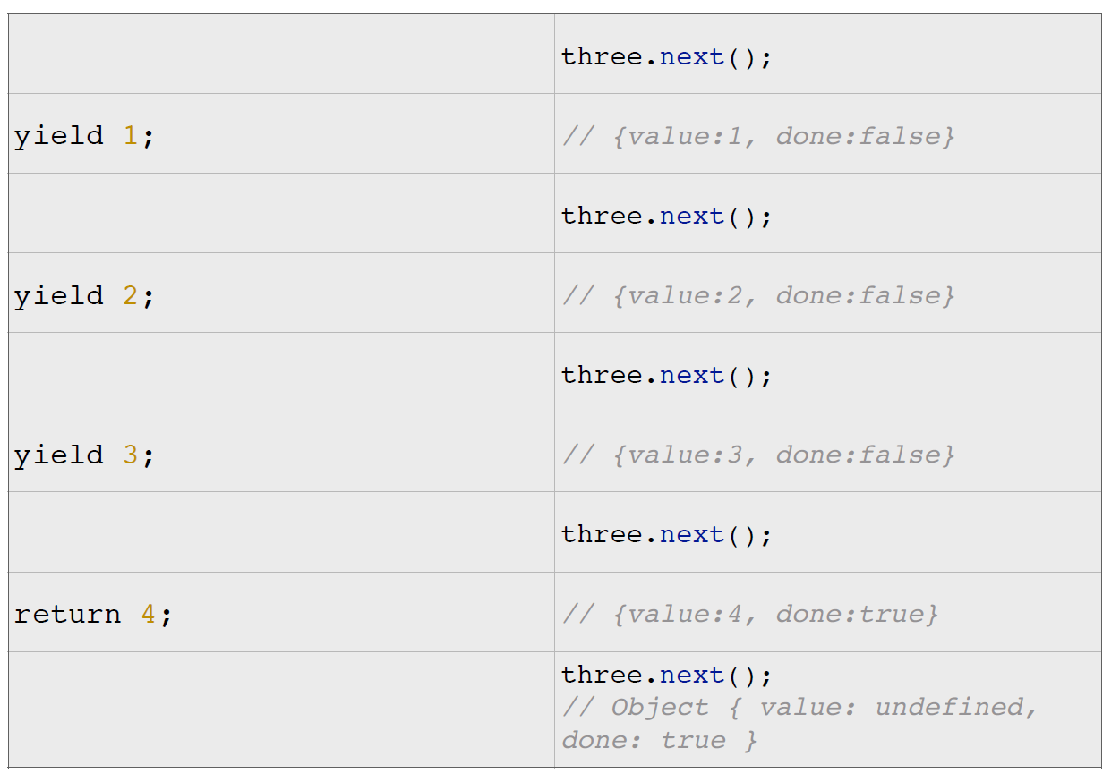
Consume generator

Slide 30
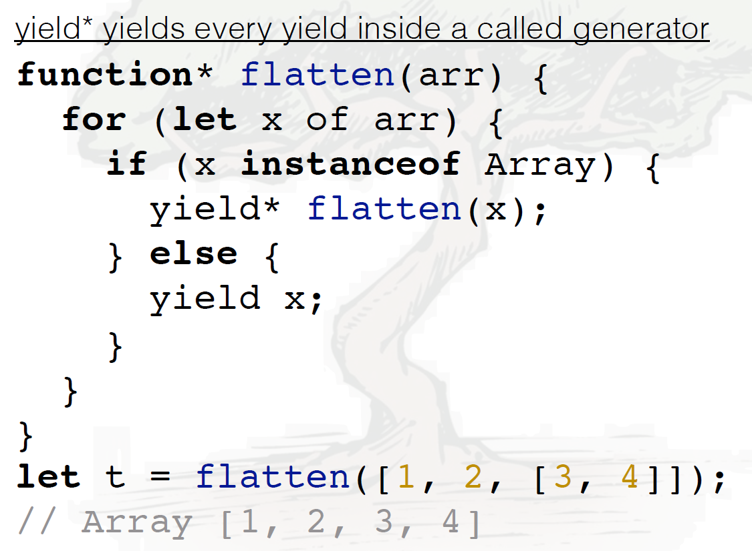
Yield*

Slide 31
Obsolete constructions
1
Replacement strings.
2
global, ignoreCase, lastIndex, multiline, source.
3
RegExp methods – compile(), Object.valueOf() – no longer specialized for RegExp.
4
Iterator – StopIteration, Iterator
5
Object methods watch, unwatch – Use Proxy instead
6
Expression closures are deprecated. Use regular functions or arrow functions instead.

Slide 32
Obsolete constructions
1
Date methods. getYear and setYear, getFullYear and setFullYear
2
Date methods. You should use toISOString instead of the deprecated toGMTString.
3
Proxy. Proxy.create and Proxy.createFunction – Use proxy instead.
4
Escape sequences. Octal escape sequences (\ followed by one, two, or three octal digits) are deprecated in string and regular expression literals.

Slide 33
Obsolete constructions
1
String methods. HTML wrapper methods like String.prototype.fontsize and String.prototype.big
2
String.prototype.quote is removed
3
Object deprecated __count__, __parent__, Object.observe(), Object.getNotifier()
4
Array – Array.observe(), Array,unobserve()
5
Number – Number.toInteger()
6
Statements – for each .. in, for .. in - Use for .. of –instead

Slide 34
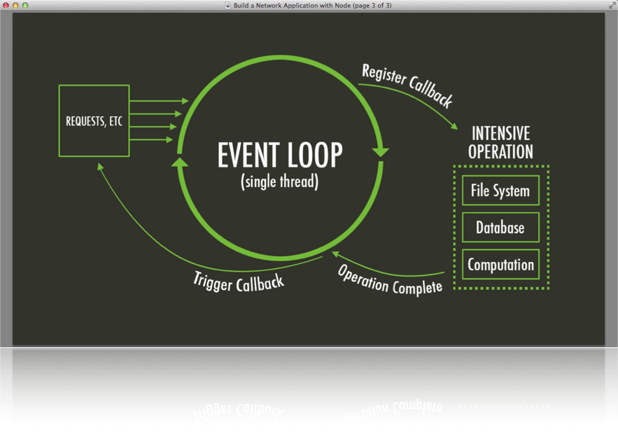
Promises

Slide 35
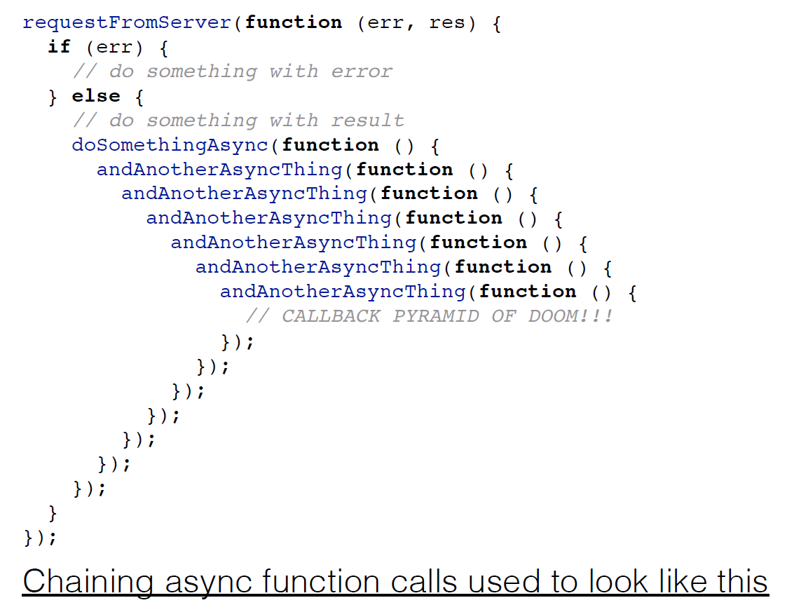
Promises

Slide 36
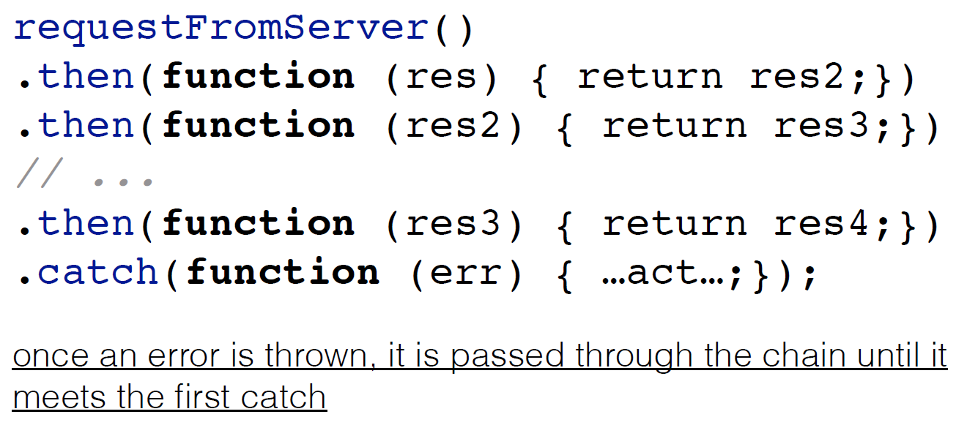
Promises

Slide 37
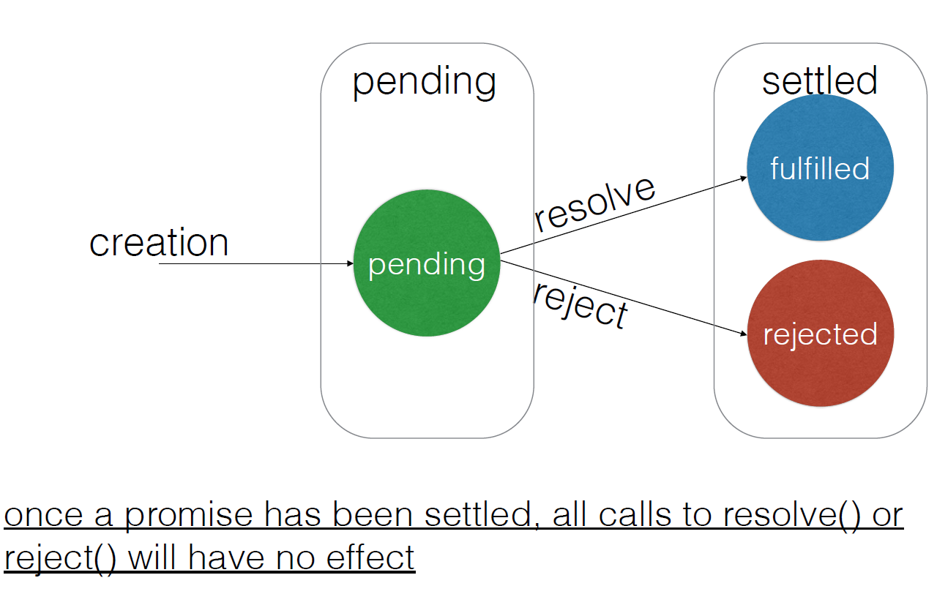
Promises

Slide 38
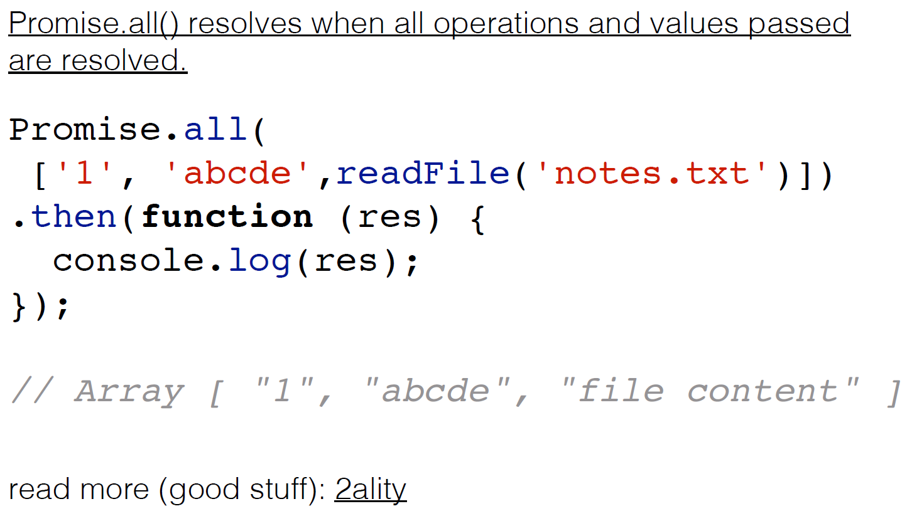
Promises

Slide 39
Thank you for your attention

